Slide 1


Lecture 1-3
DLI
Parametric Lines and Planes
直线的参数方程和平面

Slide 2
DLI
Review
Norm of a vector 向量的模；
The Distance between A and B 两点间距离；
General Pythagoras theorem 毕达哥拉斯定理；
Schwarz Inequality 施瓦茨不等式

Slide 3
DLI
Outline
Parametric Lines 直线的参数方程；
Planes 平面；

Slide 4
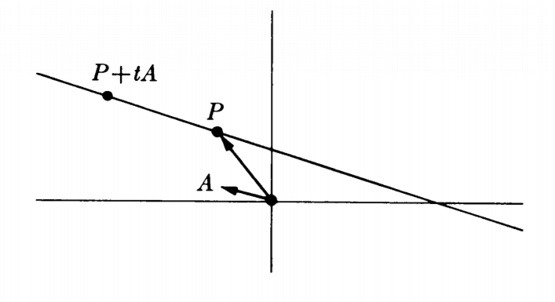
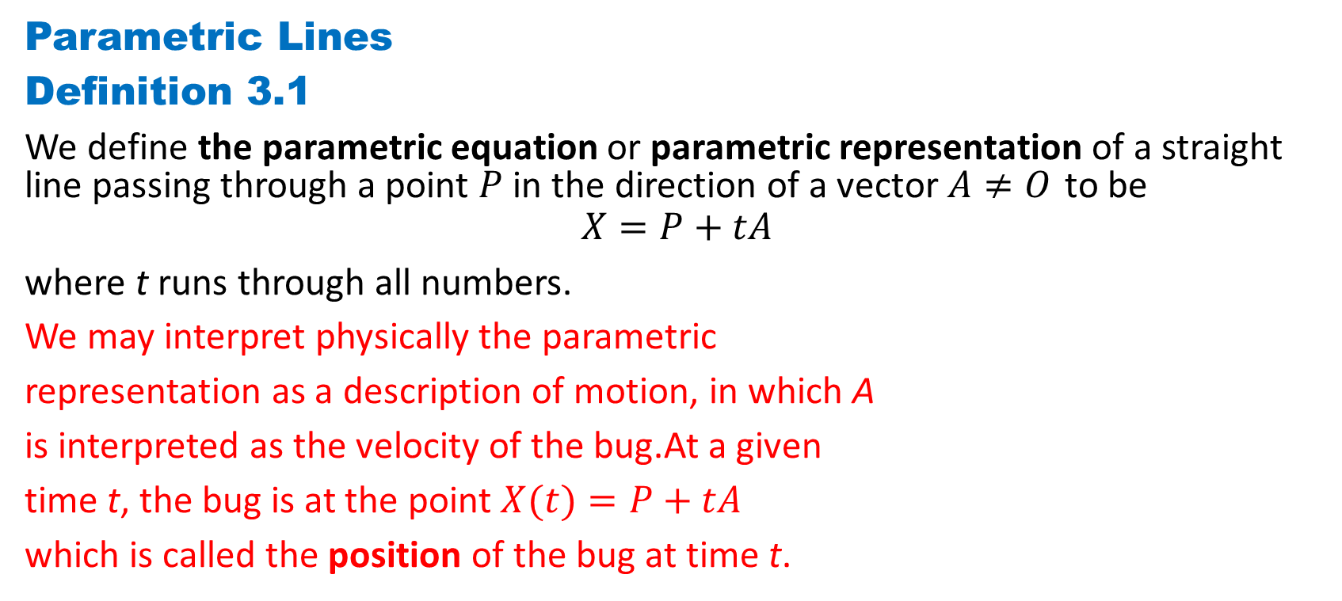
DLI
Parametric Lines
Definition 3.1
We define the parametric equation or parametric representation of a straight line passing through a point $P$ in the direction of a vector $A≠O$ to be
$$X=P+tA$$
where t runs through all numbers.
We may interpret physically the parametric
representation as a description of motion, in which A
is interpreted as the velocity of the bug.At a given
time t, the bug is at the point $X(t)=P+tA$
which is called the position of the bug at time t.

Slide 5
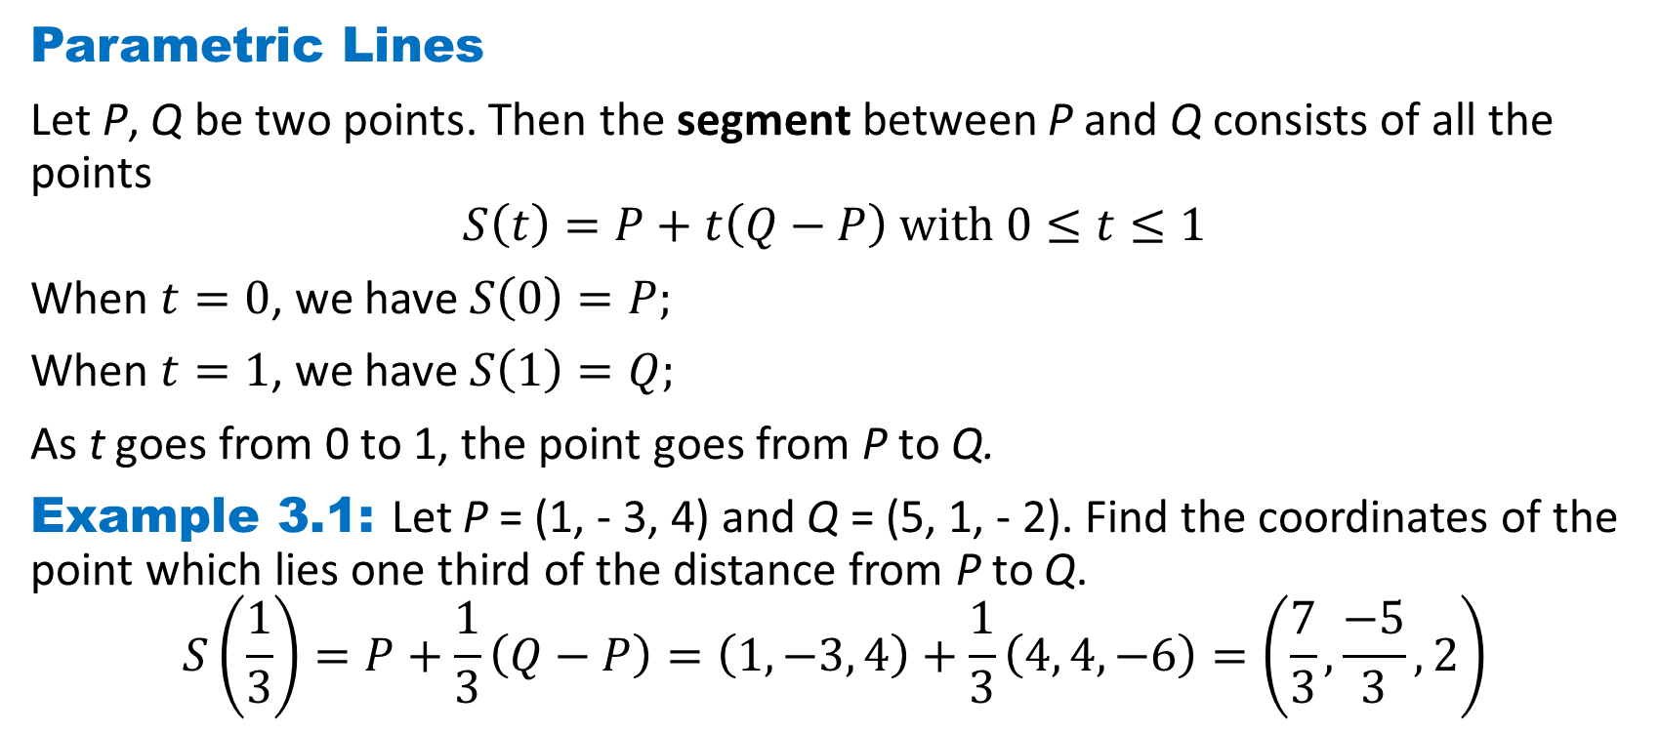
DLI
Parametric Lines
Let P, Q be two points. Then the segment between P and Q consists of all the points
$$S\left(t\right)=P+t\left(Q−P\right) with 0≤t≤1$$
When $t=0$, we have $S\left(0\right)=P;$
When $t=1$, we have $S\left(1\right)=Q;$
As t goes from 0 to 1, the point goes from P to Q.
Example 3.1: Let P = (1, - 3, 4) and Q = (5, 1, - 2). Find the coordinates of the point which lies one third of the distance from P to Q.
$$S\left(\frac{1}{3}\right)=P+\frac{1}{3}\left(Q−P\right)=\left(1, −3, 4\right)+\frac{1}{3}\left(4, 4,−6\right)=\left(\frac{7}{3}, \frac{−5}{3},2\right)$$

Slide 6
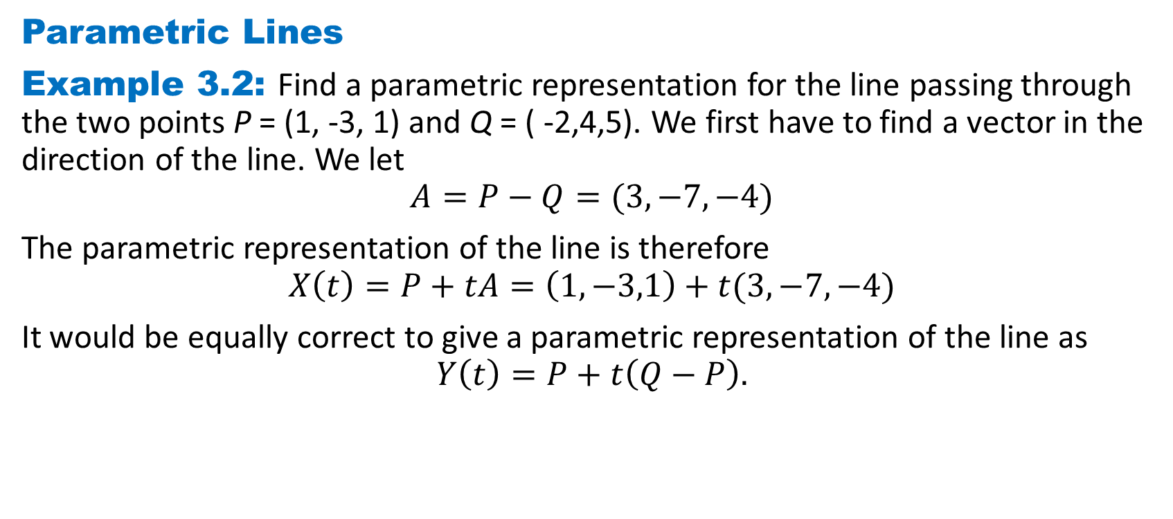
DLI
Parametric Lines
Example 3.2: Find a parametric representation for the line passing through the two points P = (1, -3, 1) and Q = ( -2,4,5). We first have to find a vector in the direction of the line. We let
$$A=P−Q=(3,−7,−4)$$
The parametric representation of the line is therefore
$$X\left(t\right)=P+tA=\left(1,−3,1\right)+t(3,−7,−4)$$
It would be equally correct to give a parametric representation of the line as
$$Y\left(t\right)=P+t\left(Q−P\right).$$

Slide 7
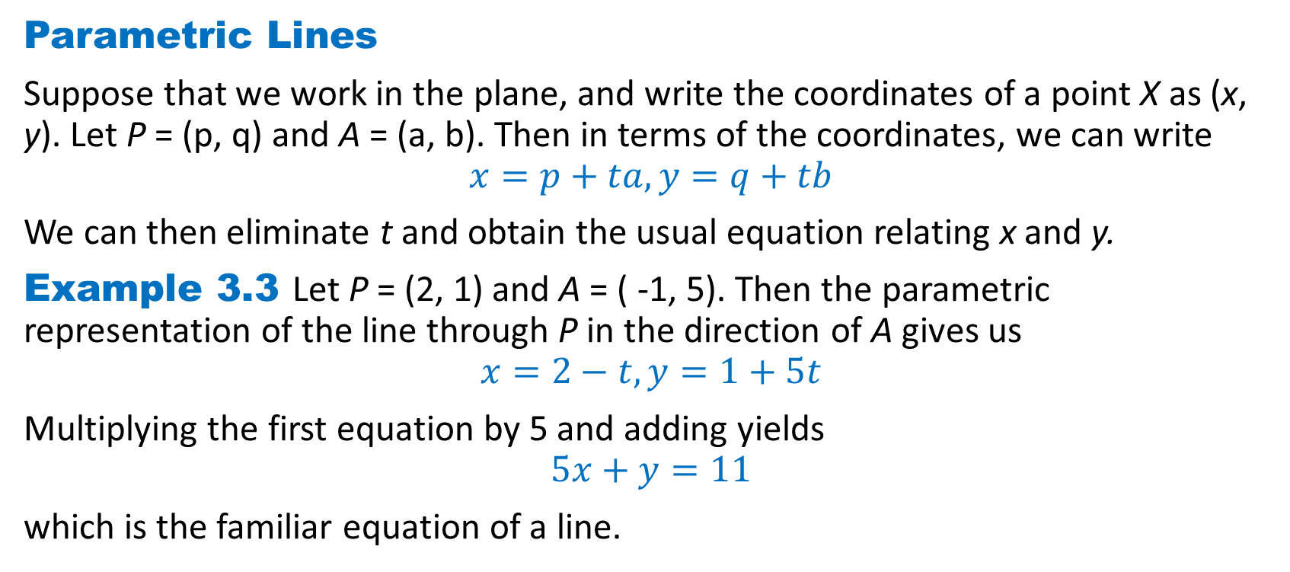
DLI
Parametric Lines
Suppose that we work in the plane, and write the coordinates of a point X as (x, y). Let P = (p, q) and A = (a, b). Then in terms of the coordinates, we can write
$$x=p+ta, y=q+tb$$
We can then eliminate t and obtain the usual equation relating x and y.
Example 3.3 Let P = (2, 1) and A = ( -1, 5). Then the parametric representation of the line through P in the direction of A gives us
$$x=2−t, y=1+5t$$
Multiplying the first equation by 5 and adding yields
$$5x+y=11$$
which is the familiar equation of a line.

Slide 8
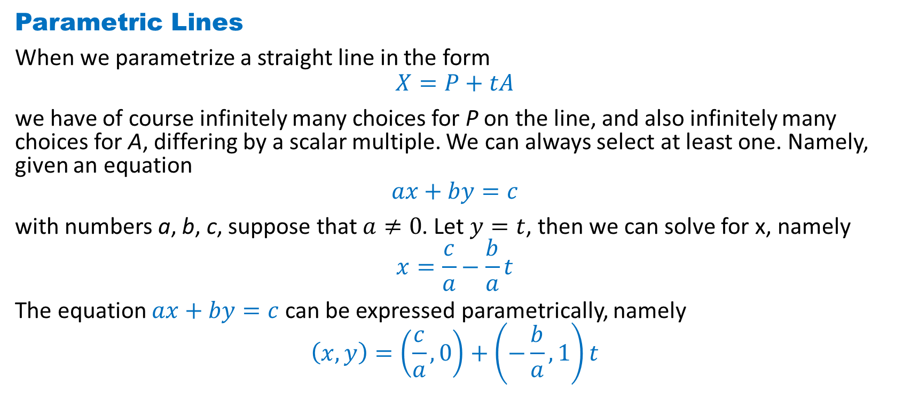
DLI
Parametric Lines
When we parametrize a straight line in the form
$$X=P+tA$$
we have of course infinitely many choices for P on the line, and also infinitely many choices for A, differing by a scalar multiple. We can always select at least one. Namely, given an equation
$$ax+by=c$$
with numbers a, b, c, suppose that $a≠0$. Let $y=t$, then we can solve for x, namely
$$x=\frac{c}{a}−\frac{b}{a}t$$
The equation $ax+by=c$ can be expressed parametrically, namely
$$\left(x,y\right)=\left(\frac{c}{a},0\right)+\left(−\frac{b}{a},1\right)t$$

Slide 9

DLI
Parametric Lines
In higher dimensions, starting with a parametric representation
$X=P+tA$
we cannot eliminate t, and thus the parametric representation is the only one available to describe a straight line.

Slide 10
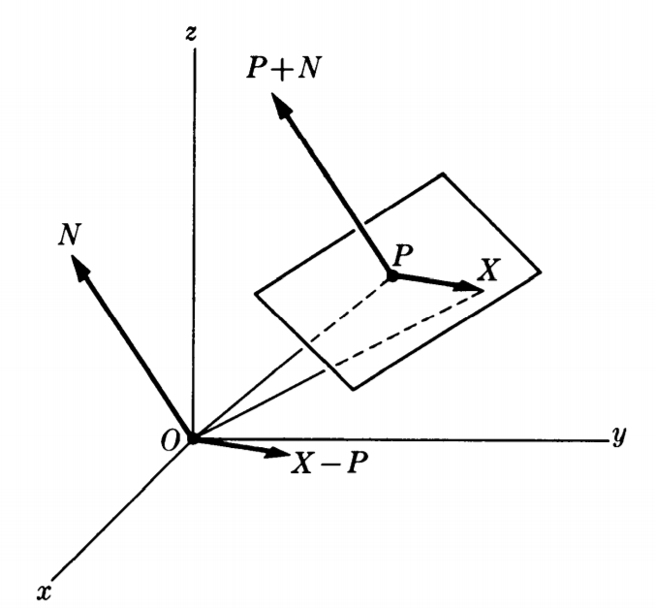
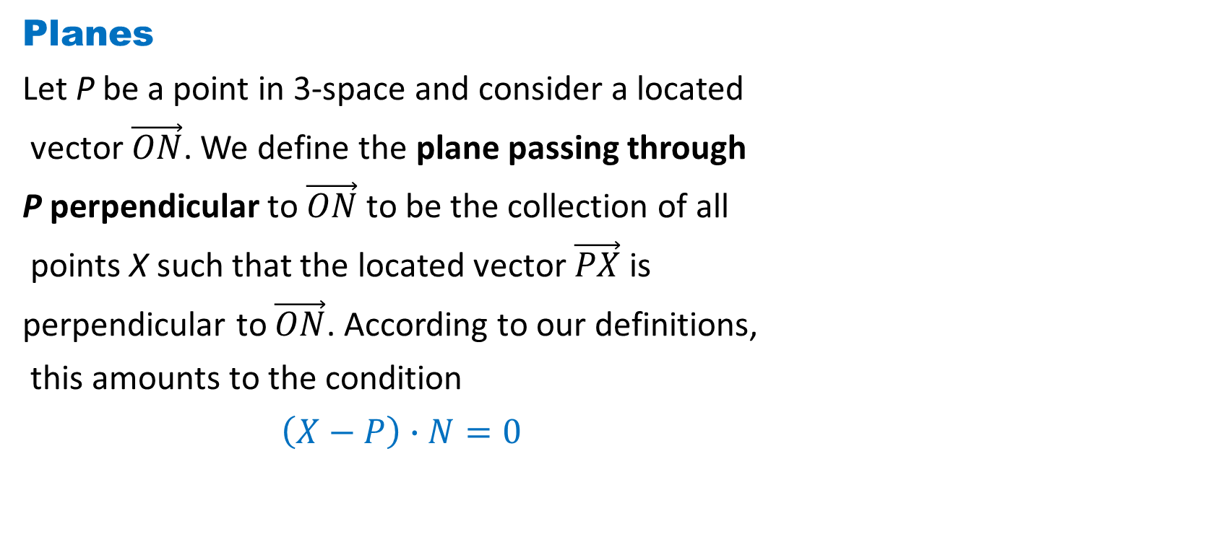
DLI
Planes
Let P be a point in 3-space and consider a located
vector $\vec{ON}$. We define the plane passing through
P perpendicular to $\vec{ON}$ to be the collection of all
points X such that the located vector $\vec{PX}$ is
perpendicular to $\vec{ON}$. According to our definitions,
this amounts to the condition
$\left(X−P\right)∙N=0$

Slide 11
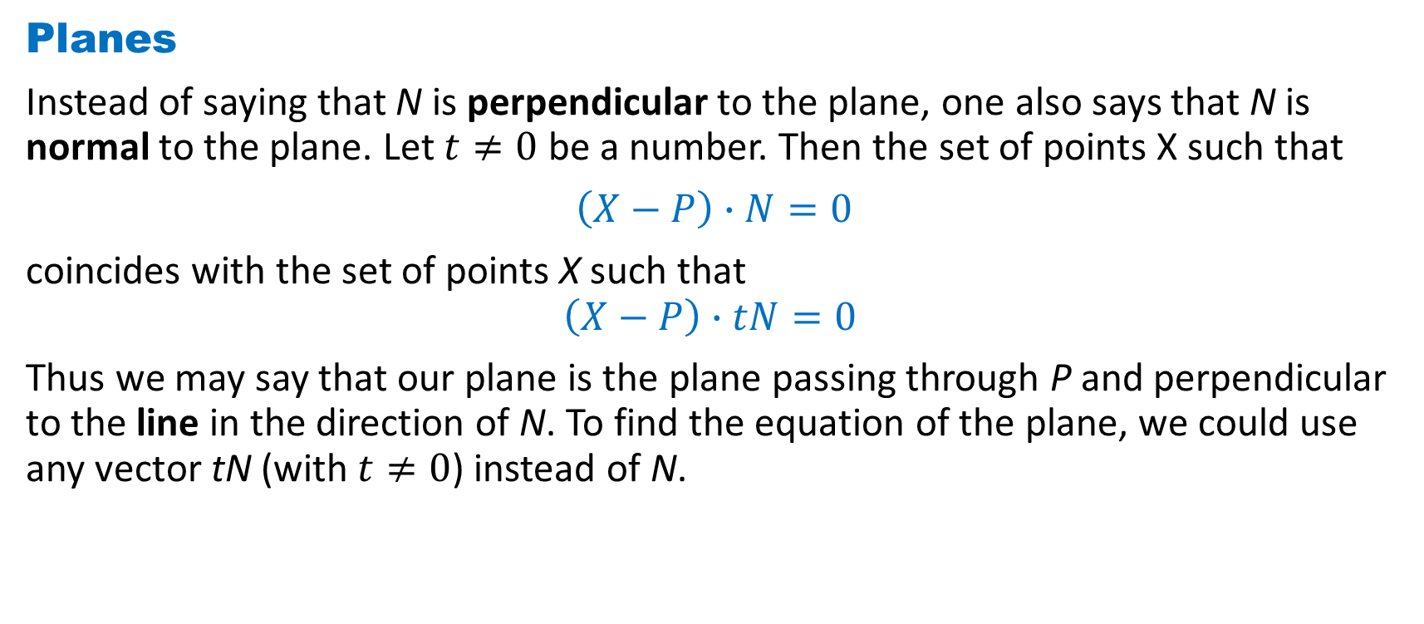
DLI
Planes
Instead of saying that N is perpendicular to the plane, one also says that N is normal to the plane. Let $t≠0$ be a number. Then the set of points X such that
$\left(X−P\right)∙N=0$
coincides with the set of points X such that
$$\left(X−P\right)∙tN=0$$
Thus we may say that our plane is the plane passing through P and perpendicular to the line in the direction of N. To find the equation of the plane, we could use any vector tN (with $t≠0$) instead of N.

Slide 12
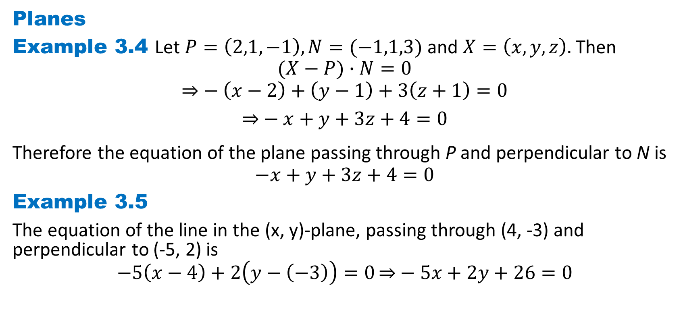
DLI
Planes
Example 3.4 Let $P=\left(2,1,−1\right),N=(−1,1,3)$ and $X=\left(x,y,z\right).$ Then
$$(X−P)∙N=0$$
$$\overset{⇒}{}−\left(x−2\right)+\left(y−1\right)+3\left(z+1\right)=0$$
$$\overset{⇒}{}−x+y+3z+4=0$$
Therefore the equation of the plane passing through P and perpendicular to N is
$$−x+y+3z+4=0$$
Example 3.5
The equation of the line in the (x, y)-plane, passing through (4, -3) and perpendicular to (-5, 2) is
$$−5\left(x−4\right)+2\left(y−\left(−3\right)\right)=0\overset{⇒}{}−5x+2y+26=0$$

Slide 13
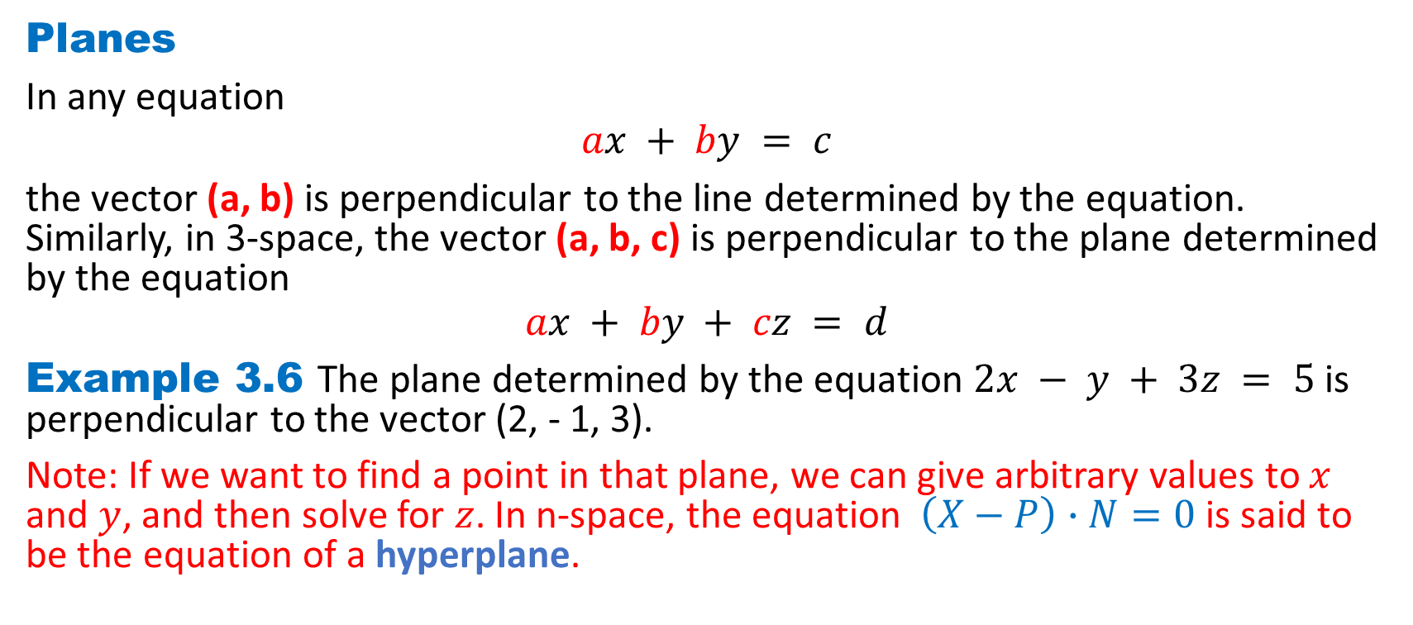
DLI
Planes
In any equation
$$ax + by = c$$
the vector (a, b) is perpendicular to the line determined by the equation. Similarly, in 3-space, the vector (a, b, c) is perpendicular to the plane determined by the equation
$$ax + by + cz = d$$
Example 3.6 The plane determined by the equation $2x − y + 3z = 5$is perpendicular to the vector (2, - 1, 3).
Note: If we want to find a point in that plane, we can give arbitrary values to $x$ and $y$, and then solve for $z$. In n-space, the equation $\left(X−P\right)∙N=0$ is said to be the equation of a hyperplane.

Slide 14
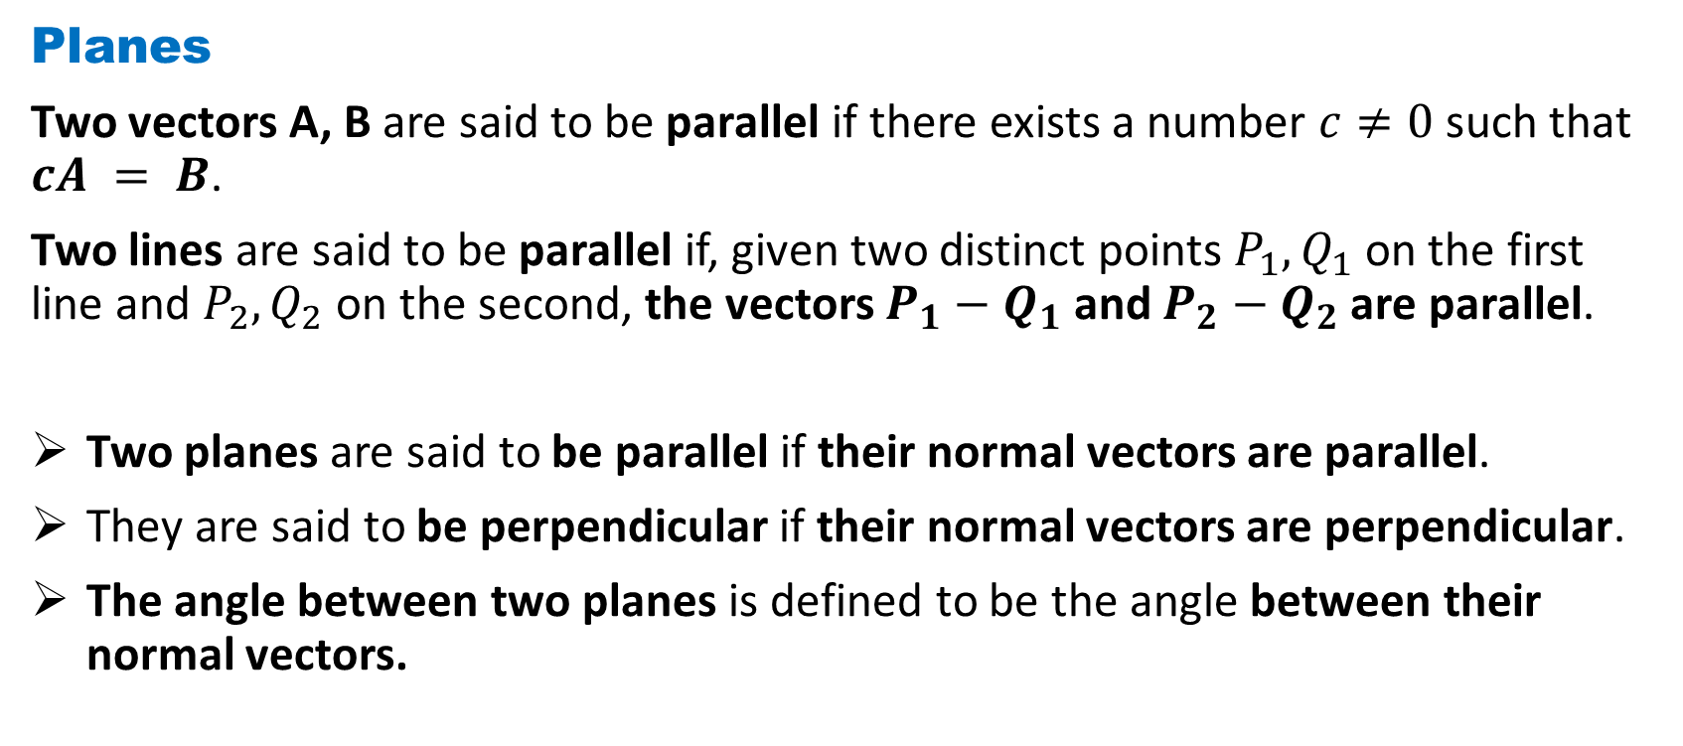
DLI
Planes
Two vectors A, B are said to be parallel if there exists a number $c≠0$ such that $cA = B$.
Two lines are said to be parallel if, given two distinct points $P_{1},Q_{1}$ on the first line and $P_{2},Q_{2}$ on the second, the vectors $P_{1}−Q_{1}$ and $P_{2}−Q_{2}$ are parallel.
Two planes are said to be parallel if their normal vectors are parallel.
They are said to be perpendicular if their normal vectors are perpendicular.
The angle between two planes is defined to be the angle between their normal vectors.

Slide 15
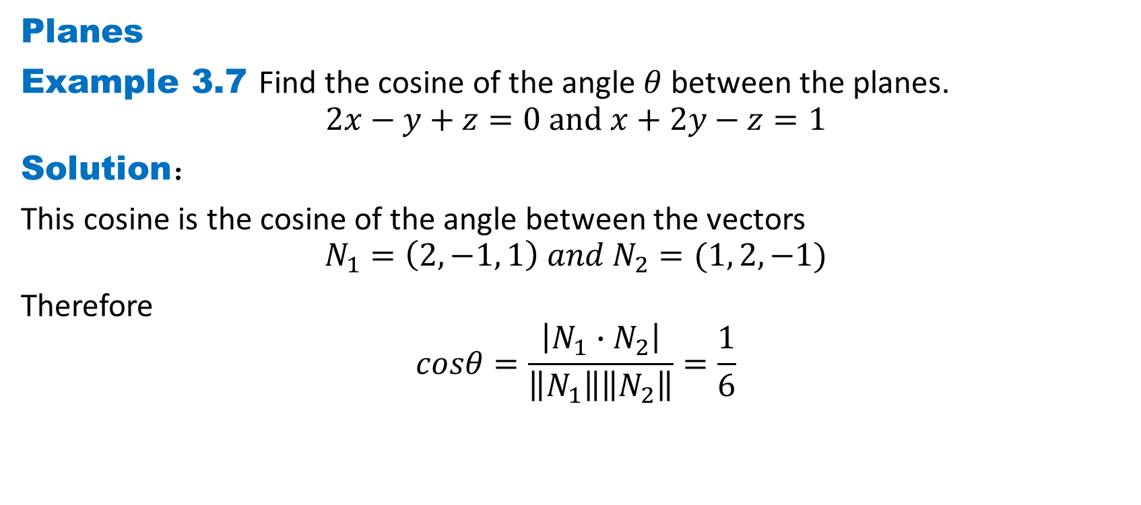
DLI
Planes
Example 3.7 Find the cosine of the angle $θ$ between the planes.
$$2x−y+z=0 and x+2y−z=1$$
Solution：
This cosine is the cosine of the angle between the vectors
$$N_{1}=\left(2, −1, 1\right) and N_{2}=(1, 2, −1)$$
Therefore
$$cosθ=\frac{\left|{N_{1}∙N}_{2}\right|}{\left\|N_{1}\right\|\left\|N_{2}\right\|}=\frac{1}{6}$$

Slide 16
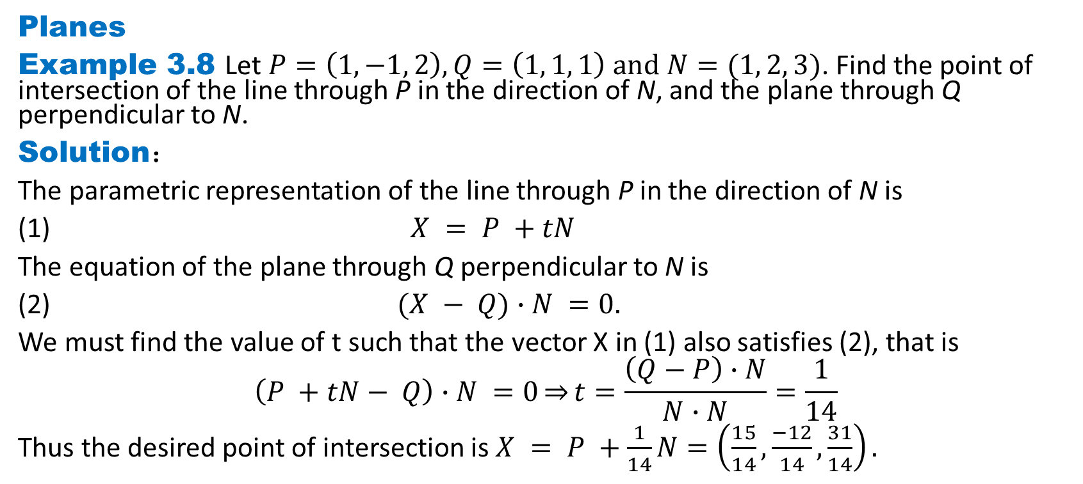
DLI
Planes
Example 3.8 Let $P=\left(1, −1, 2\right), Q=\left(1, 1, 1\right) and N=(1, 2, 3)$. Find the point of intersection of the line through P in the direction of N, and the plane through Q perpendicular to N.
Solution：
The parametric representation of the line through P in the direction of N is
(1) $X = P +tN$
The equation of the plane through Q perpendicular to N is
(2) $(X − Q)∙N =0.$
We must find the value of t such that the vector X in (1) also satisfies (2), that is
$$\left(P +tN− Q\right)∙N =0\overset{⇒}{}t=\frac{\left(Q−P\right)∙N}{N∙N}=\frac{1}{14}$$
Thus the desired point of intersection is $X = P +\frac{1}{14}N=\left(\frac{15}{14},\frac{−12}{14},\frac{31}{14}\right).$

Slide 17
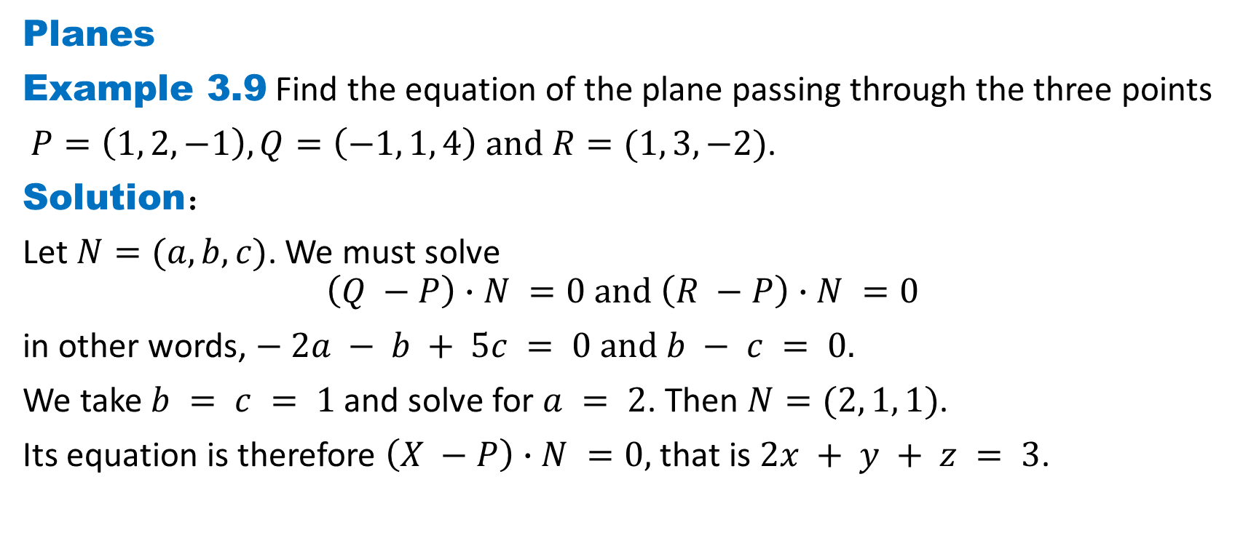
DLI
Planes
Example 3.9 Find the equation of the plane passing through the three points
$P=\left(1, 2, −1\right), Q=\left(−1, 1, 4\right) and R=(1, 3, −2)$.
Solution：
Let $N=(a,b,c)$. We must solve
$$\left(Q −P\right)∙N =0 and \left(R −P\right)∙N =0$$
in other words, $− 2a − b + 5c = 0 and b − c = 0.$
We take $b = c = 1$and solve for $a = 2$. Then $N=(2, 1, 1)$.
Its equation is therefore $\left(X −P\right)∙N =0,$ that is $2x + y + z = 3$.

Slide 18
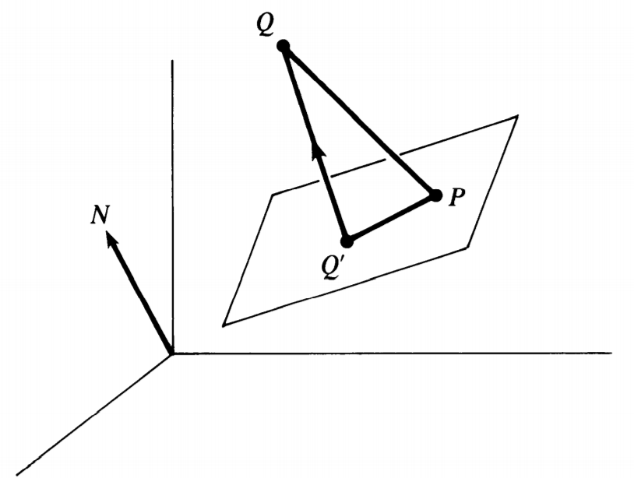
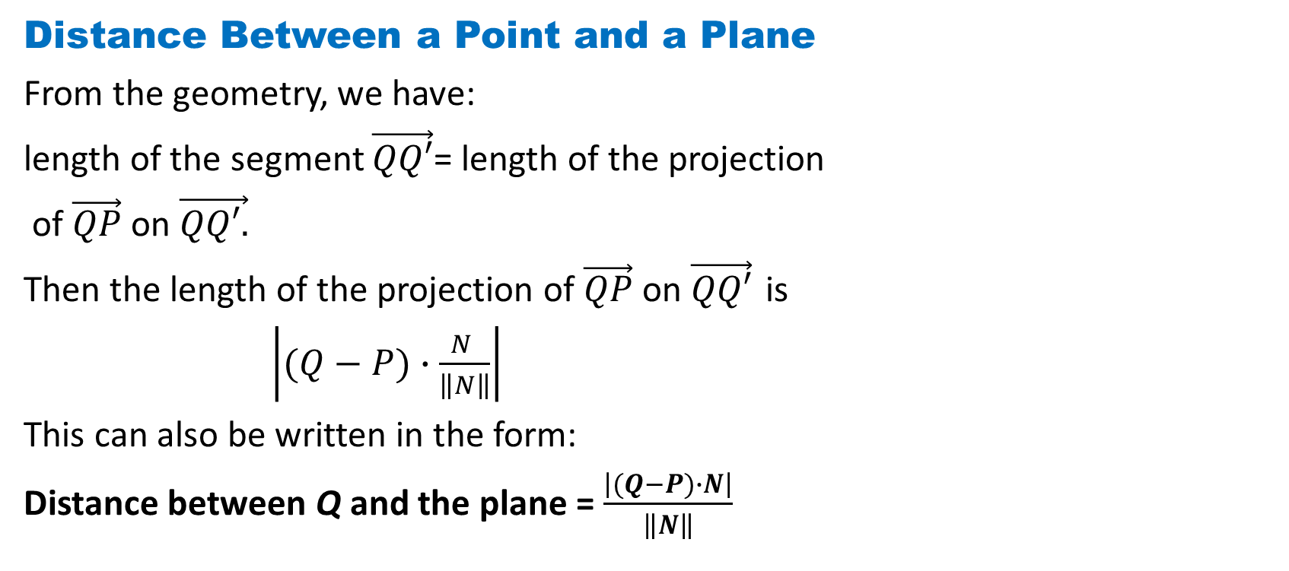
DLI
Distance Between a Point and a Plane
From the geometry, we have:
length of the segment $\vec{QQ′}$= length of the projection
of $\vec{QP}$ on $\vec{QQ′.}$
Then the length of the projection of $\vec{QP}$ on $\vec{QQ′}$ is
$\left|(Q−P)∙\frac{N }{\left\|N\right\|}\right|$
This can also be written in the form:
Distance between Q and the plane = $\frac{\left|(Q−P)∙N\right|}{\left\|N\right\|}$

Slide 19
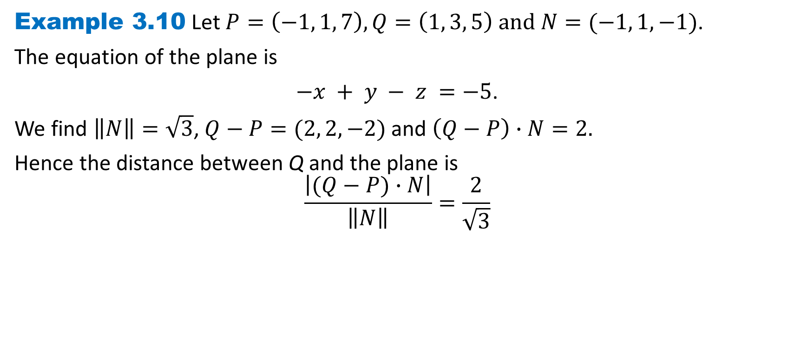
DLI
Example 3.10 Let $P=\left(−1, 1, 7\right), Q=\left(1, 3, 5\right) and N=(−1, 1, −1)$.
The equation of the plane is
$−x + y − z =−5$.
We find $\left\|N\right\|=\sqrt{3}$, $Q−P=(2, 2,−2)$ and $\left(Q−P\right)∙N=2.$
Hence the distance between Q and the plane is
$$\frac{\left|(Q−P)∙N\right|}{\left\|N\right\|}=\frac{2}{\sqrt{3}}$$

Slide 20
DLI
Homework 1-3
Exercise 1.5 Page 34
Q1, Q5
Exercise 1.6 Page 40
Q2, Q10, Q15

